Slide 1
Welcome
to My
Presentation!

Slide 2

Presentation on CSE 331
Lecture: 35
Presented by
Syeda Nowshin Ibnat
ID: 17183103020
Intake: 39 (section:1)
Dept. of Computer Science and Engineering

Slide 3
1
1
List of Topics
01
File Input/Output: Exploring java.io
02
FileInputStream
03
FileOutputStream
04
ByteArrayInputStream
05
ByteArrayOutputStream

Slide 4
1 File Input/Output: Exploring java.io

Slide 5
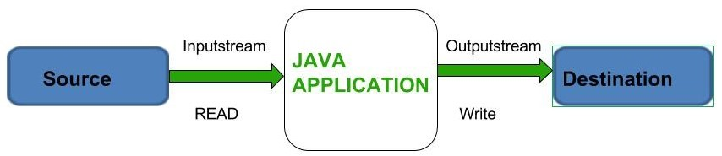
What is java.io?
What is File?
Using File in java.io
A file is a named location that can be used to store related information.
For example, main.java is a Java file that contains information about the Java program.
The File class of the java.io package is used to perform various operations on files and directories(collection of files and subdirectories).
What is File I/O?
File Input → Data Read
File Output → Data Write
The java.io package contains nearly every class you might ever need to perform input and output (I/O) in Java.

Slide 6
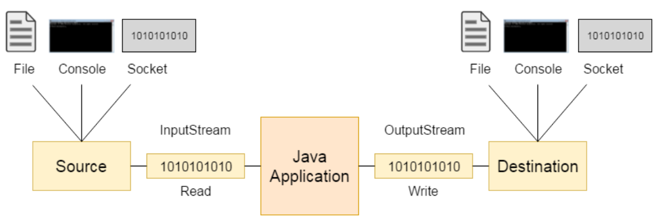
What is Stream?
A stream can be defined as a sequence of data. The stream in the java.io package supports many data such as primitives, object etc.
There are two kinds of Streams −
InPutStream − The InputStream is used to read data from a source.
OutPutStream − The OutputStream is used for writing data to a destination.

Slide 7
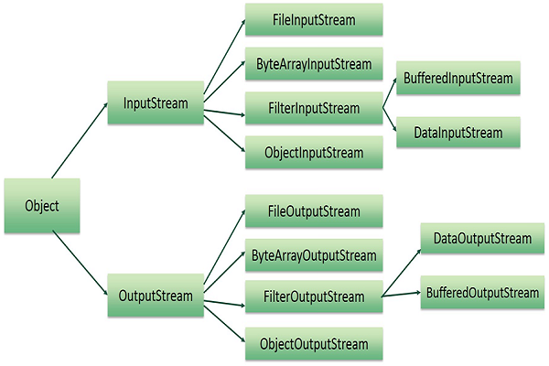
What is Byte Stream?
Byte stream is used to read and write a single byte (8 bits) of data, whereas Java Character streams are used to perform input and output for 16-bit unicode.
Though there are many classes related to byte streams but the most frequently used classes are, FileInputStream and FileOutputStream.

Slide 8
2 FileInputStream

Slide 9
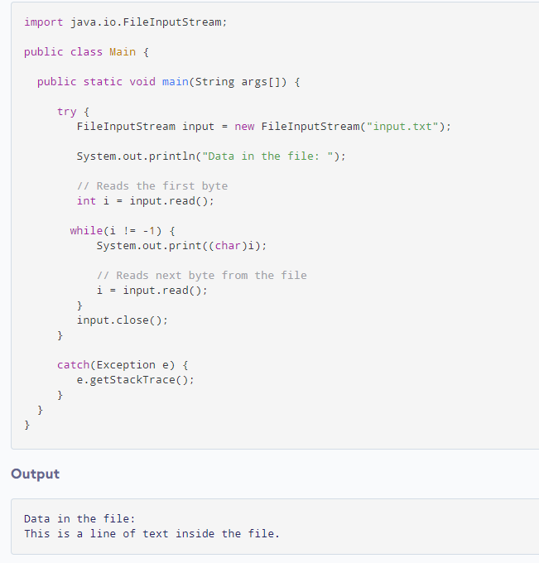
The FileInputStream class creates an InputStream that you can use to read bytes from a file.
Input:
Output:

Slide 10
3 FileOutputStream

Slide 11
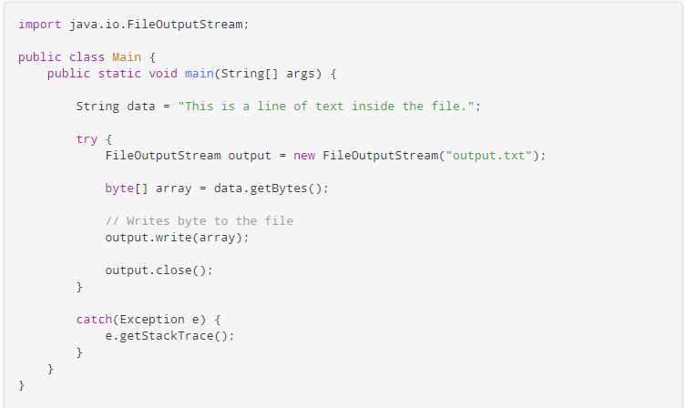
The FileOutputStream class provides implementations for different methods present in the OutputStream class.
Input:
Output:

Slide 12
4 ByteArrayInputStream

Slide 13
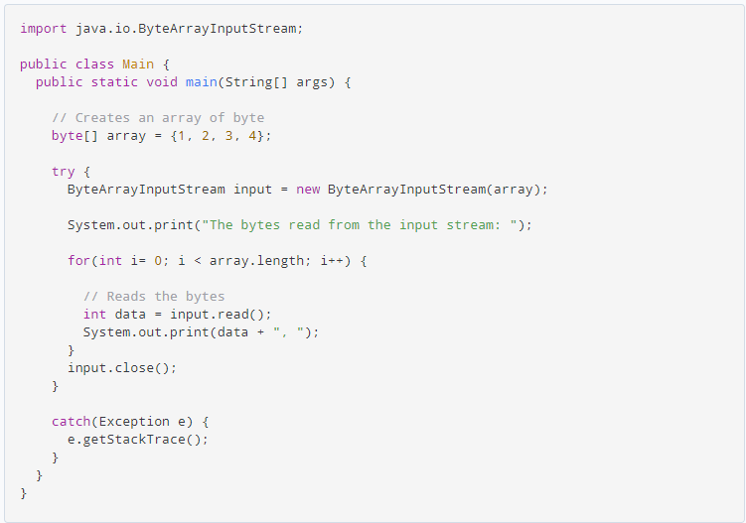
The ByteArrayInputStream class of the java.io package can be used to read an array of input data (in bytes).
Input:
Output:

Slide 14
5 ByteArrayOutputStream

Slide 15
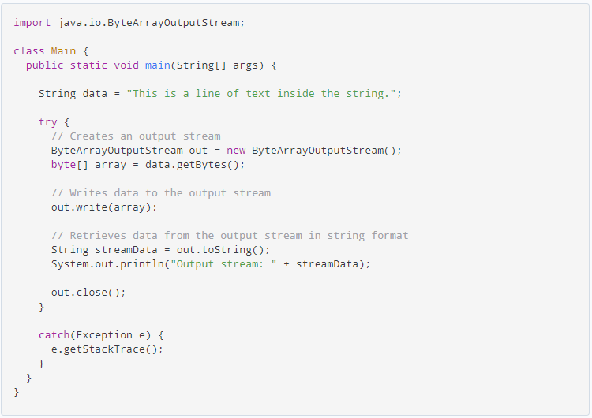
The ByteArrayOutputStream class of the java.io package can be used to write an array of output data (in bytes).
Input:
Output:

Slide 16
Reference
Websites:
1) Programiz
https://www.programiz.com/
2) Tutorialspoint
https://www.tutorialspoint.com/java/index.htm
3) JavaTpoint
https://www.javatpoint.com/java-tutorial
Book:
The Complete reference by Herbert Schildt, 9th edition

Slide 17
Thank You!

